Slide 1
Testing Wavelet Denoising

Slide 2
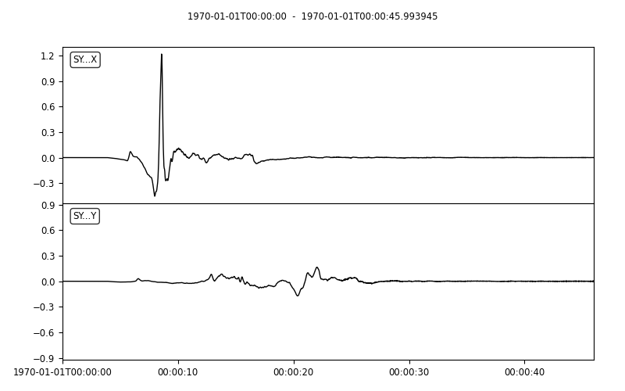
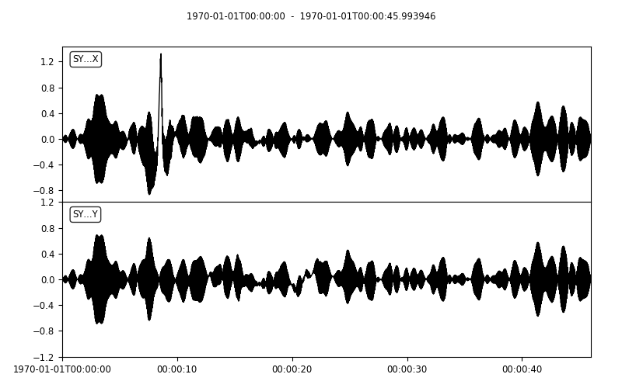
Wavelet Denoising Examples Original and noisy (working out the noise issues …)

Slide 3
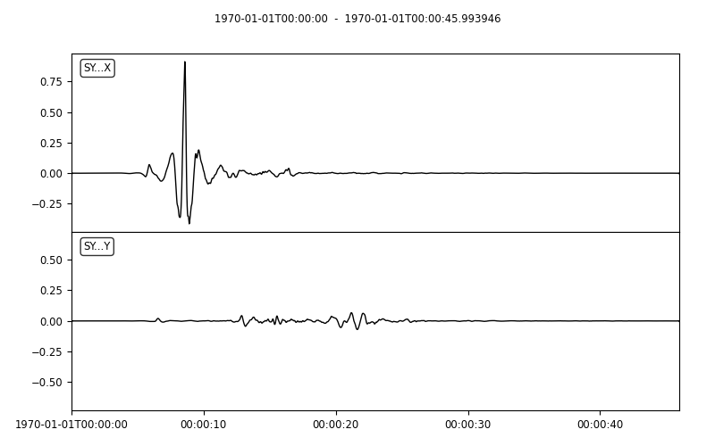
Reconstructed signal (using soft threshold and Coiflet wavelet)

Slide 4
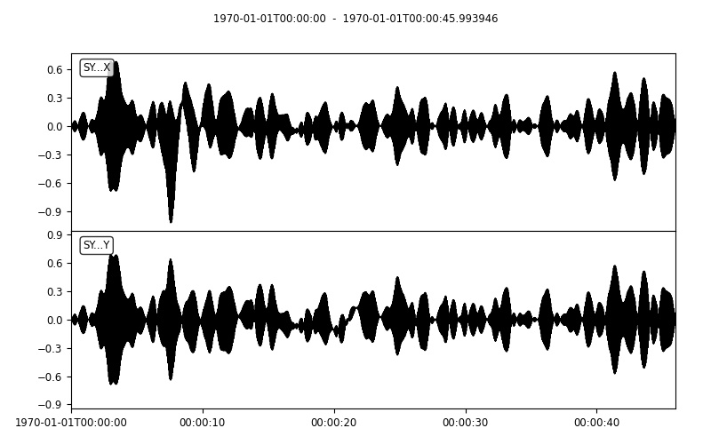
Noisy signal and reconstructed noise (using soft threshold and Coiflet wavelet)

Slide 5
Original (left) and reconstructed signal (right)

Slide 6
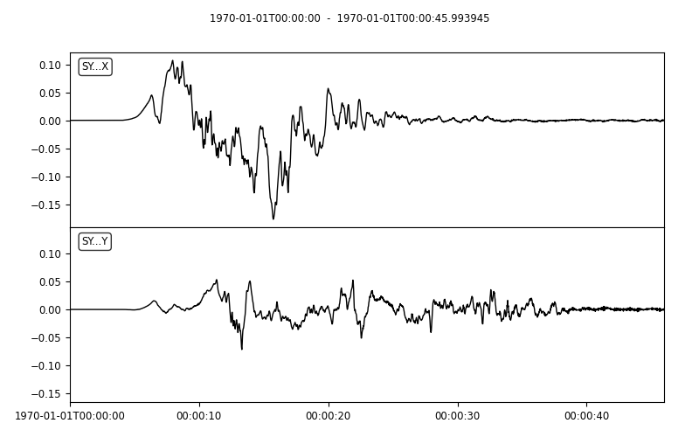
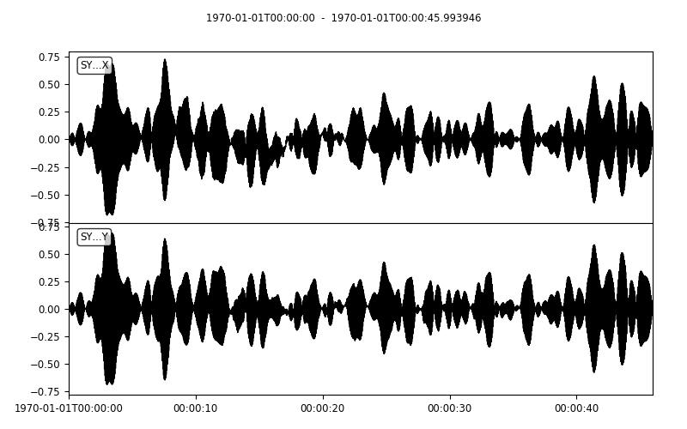
The other synthetic series, original and noisy
Mostly washed out by noise

Slide 7
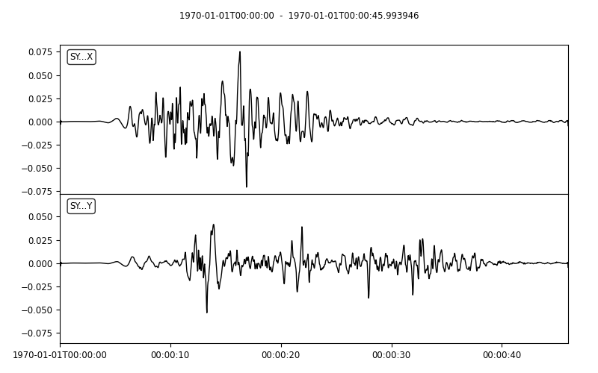
Reconstructed signal using soft threshold and Coiflet wavelet

Slide 8

Original noisy signal (left) and reconstructed noise (right)

Slide 9
Original signal (left) and reconstructed signal (right)

